Slide 1
Digital Communication 24EC2208
Digital Carrier Modulation

Slide 2
Digital Carrier Modulation / Pass Band Modulation

Slide 3
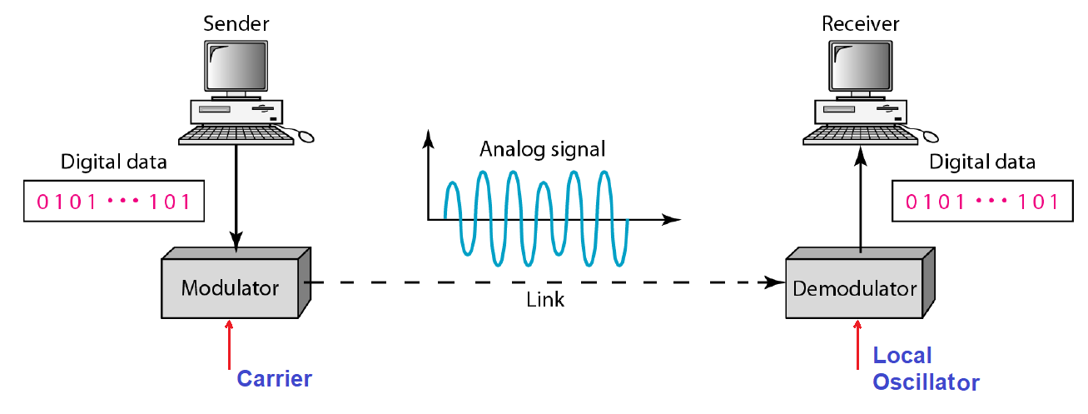
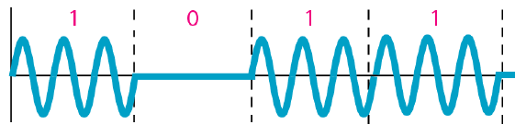
Pass-band Digital Transmitter

Slide 4
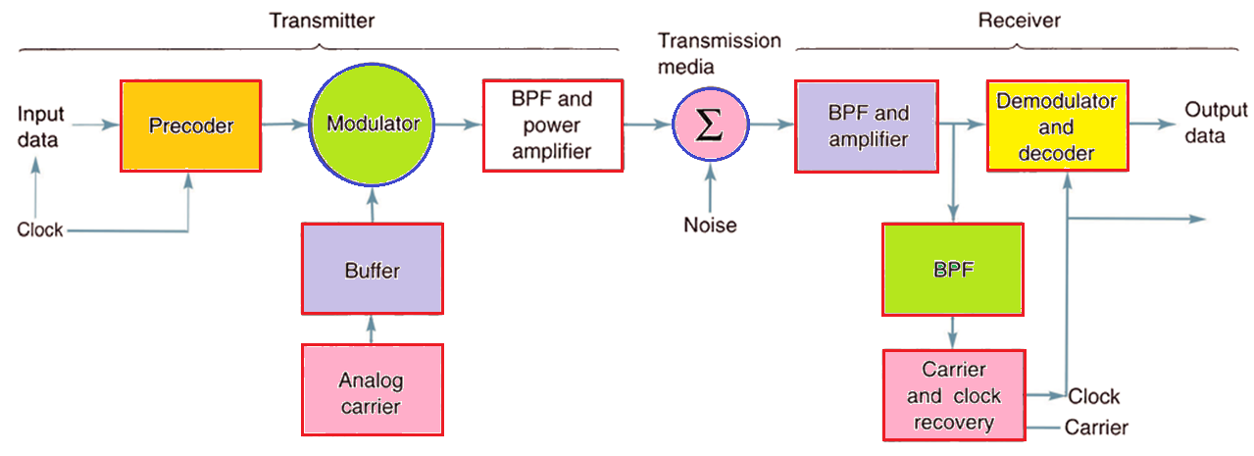
Digital Communication / Digital Radio
The transmission medium can be a metallic cable, optical fiber cable, Earth’s atmosphere, or a combination of two or more types of transmission systems.
The clock and carrier recovery circuits recover the analog carrier and digital timing (clock) signals from the incoming modulated wave since they are necessary to perform the de- modulation process.
Performs level conversion and then encodes the incoming data into groups of bits that modulate an analog carrier

Slide 5
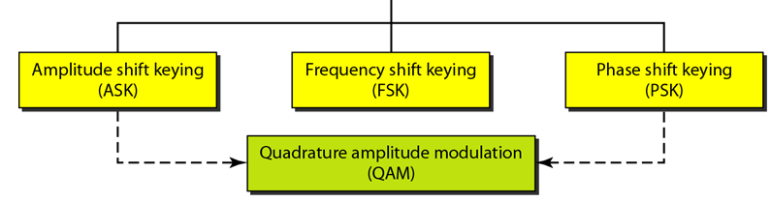
Digital Modulation Techniques

Slide 6
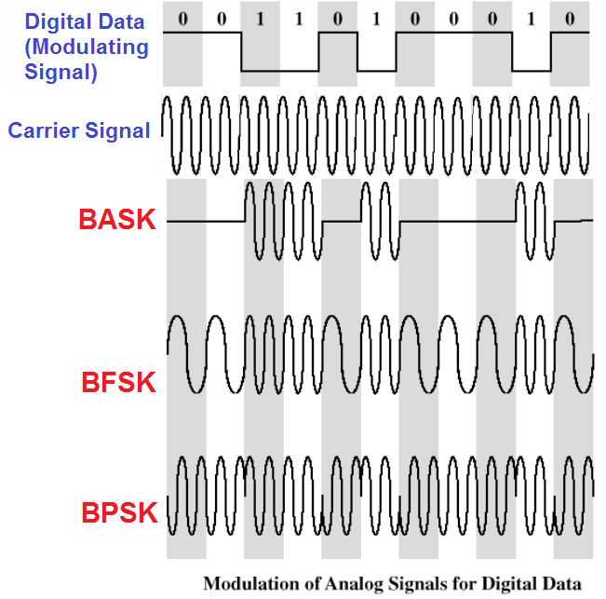

Slide 7
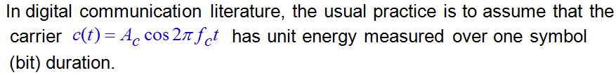

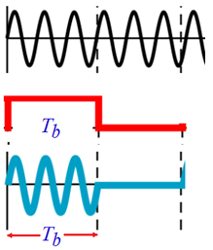





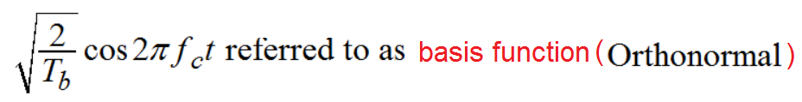
Fundamentals

Slide 8
Binary Amplitude Shift Keying (BASK)
Amplitude-shift keying (ASK) was probably the first type of digital modulation to be practically applied. In its simplest form it has been used for radio telegraphy transmission in Morse code.

Slide 9
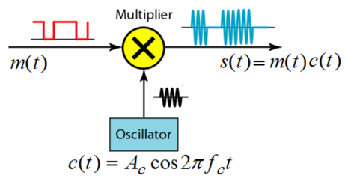


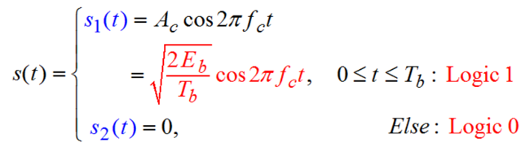

BASK
In BASK a sinusoidal carrier is simply gated on and off by the bit sequence to be transmitted.

Slide 10
The amplitude of a carrier is switched or keyed by the binary signal m(t).This is sometimes called on-off keying (OOK).

Slide 11
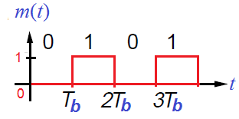
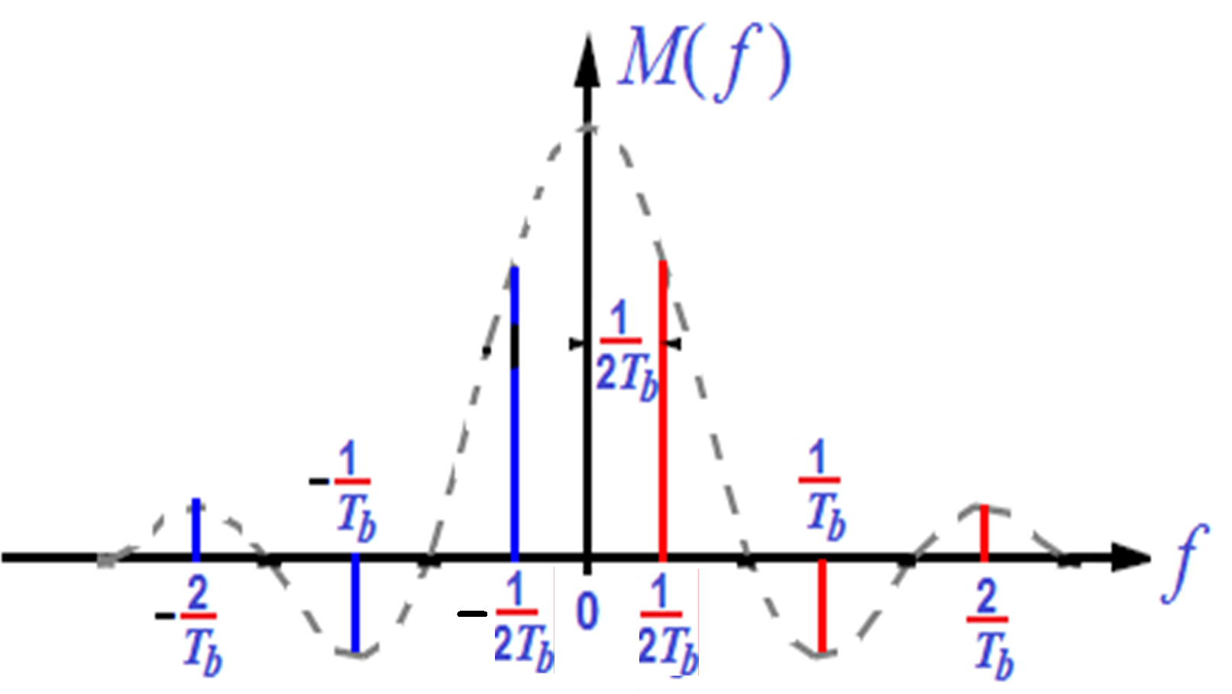

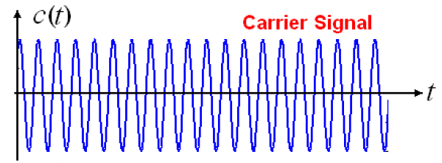
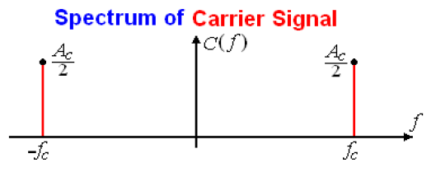
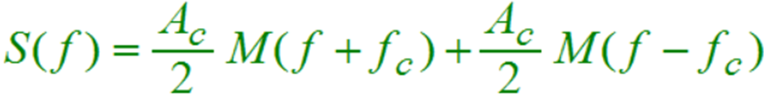
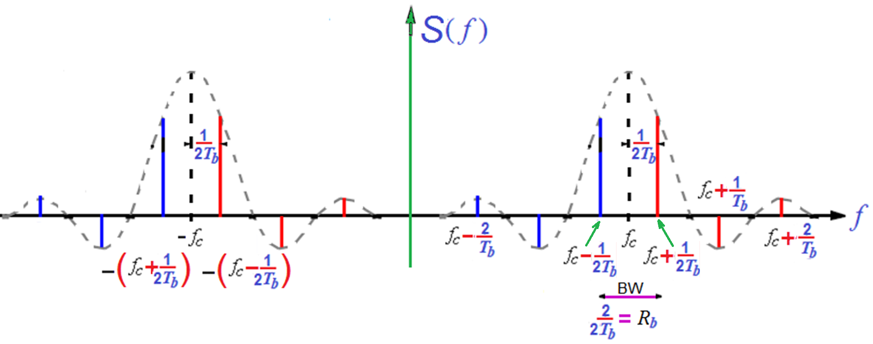
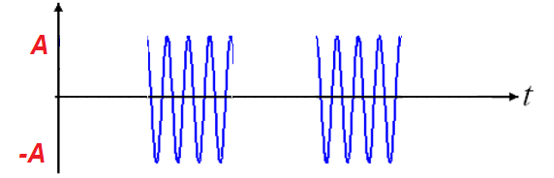

Slide 12
Bandwidth of ASK
Bandwidth = bit rate
BW can be defined in two ways:
(a), bandwidth in hertz, refers to the range of frequencies in a composite signal or the range of frequencies that a channel can pass.
(b) bandwidth in bits per second, refers to the speed of bit transmission in a channel or link. Often referred to as Capacity

Slide 13
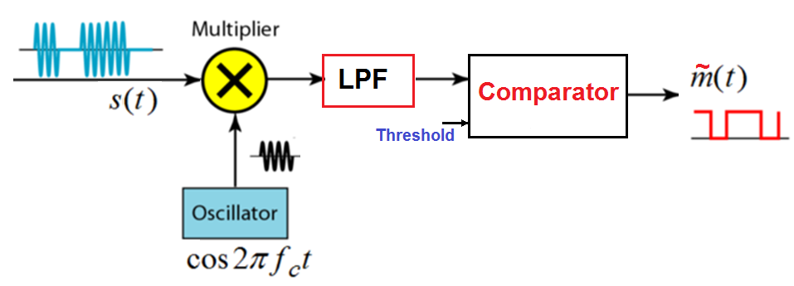
ASK Transmitter and Receiver

Slide 14
Advantages and Dis-advantages
Advantage:
simplicity
Disadvantages:
ASK is very susceptible to noise interference noise usually (only)affects the amplitude, therefore ASK is the modulation technique most affected by noise
Application: ASK is used to transmit digital data over optical fiber

Slide 15
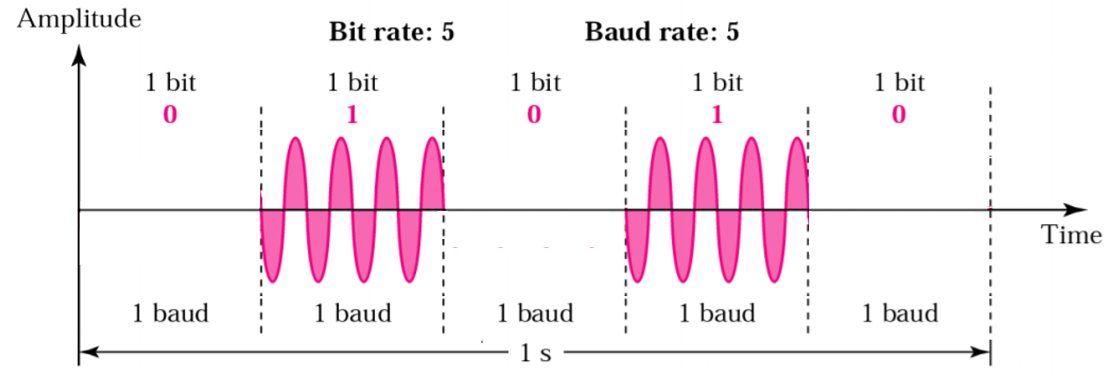
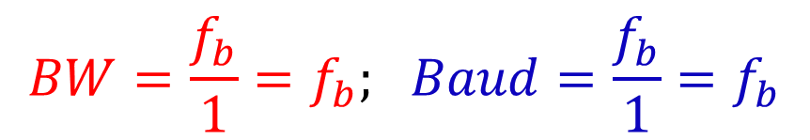
Bit rate, Baud rate and Bandwidth for ASK
Bit rate is the number of bits transmitted per second.
Baud rate is the number of signal units transmitted per second. Baud rate is less than or equal to the bit rate.
In ASK, the bit rate is equal to the minimum Nyquist bandwidth
$$BW=\frac{f_{b}}{1}=f_{b}; Baud=\frac{f_{b}}{1}=f_{b}$$

Slide 16
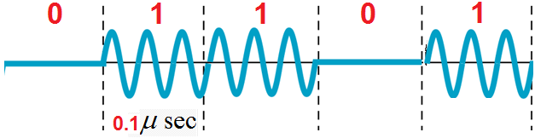
Consider an ASK modulated signal shown below. Find the bit rate and baud rate.

Slide 17
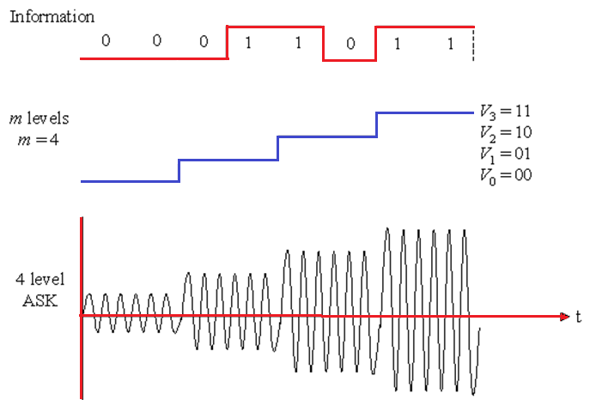

Slide 18
Ex1: Find the minimum bandwidth required for an ASK signal transmitting at 2000 bps.
Ans: In ASK the baud rate and bit rate are the same.
The baud rate is therefore 2000.
An ASK signal requires a minimum bandwidth equal to its baud rate.
Therefore, the minimum bandwidth is 2000 Hz.
Ex2: Given a bandwidth of 5000 Hz for an ASK signal, what are the baud rate and bit rate?
In ASK the baud rate is the same as the bandwidth, which means the baud rate is 5000.
But because the baud rate and the bit rate are also the same for ASK, the bit rate is 5000 bps.

Slide 19
Ex3: Determine the baud and minimum bandwidth necessary to pass a 10 kbps binary signal using amplitude shift keying.
Ans: For ASK, n = 1,
Minimum bandwidth = B = 10,000 / 1 = 10,000.
baud = 10, 000 /1 = 10,000.

Slide 20
Constellation Diagram
A graphical representation of the complex envelope of each possible signal.
The x-axis represents the in-phase component and the y-axis represents the quadrature component of the complex envelope.
The distance between signals on a constellation diagram relates to how different the modulation waveforms are and how well a receiver can differentiate between them when random noise is present.

Slide 21
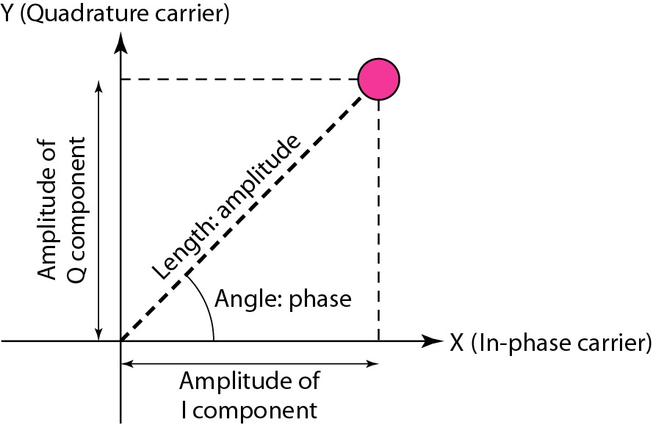

Slide 22
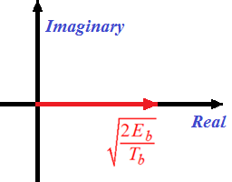
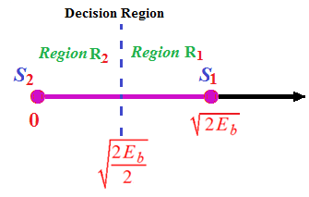

Signal Space: ASK Constellation Diagram

Slide 23
Error Performance of ASK

Slide 24

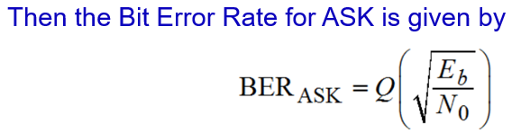
Error Performance: Bit Error Rate (BER)

Slide 25
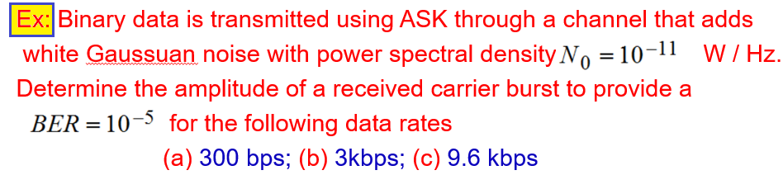




Slide 26

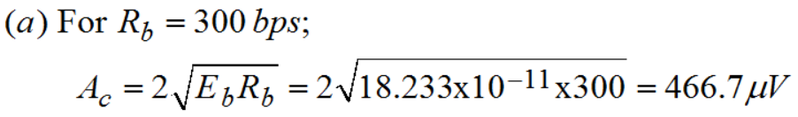
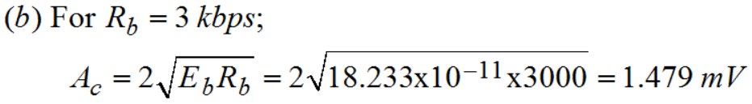
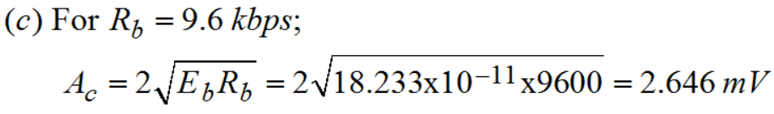
Ex…

Slide 27
End
Amplitude Shift Keying (ASK): Bandwidth = bit rate.
Frequency Shift Keying (FSK): Bandwidth = 2 x (frequency deviation + bit rate).
Phase Shift Keying (PSK): Bandwidth = bit rate.
Quadrature Phase Shift Keying (QPSK): Bandwidth = 2 x bit rate

